Slide 1
Chapter 1 INTRODUCTION AND DEFINITION
OF TERMS
  INTRODUCTION
Thermodynamics is concerned with the behavior of matter, where matter is anything that occupies space, and the matter which is the subject of a thermodynamic analysis is called a system. In materials science and engineering the systems to which thermodynamic principles are applied are usually chemical reaction systems. The central aim of applied thermodynamics is the determination of the effect of environment on the state of rest (equilibrium state), of a given system, where environment is generally determined as the pressure exerted on the system and the temperature of the system. The aim of applied thermodynamics is thus the establishment of the relationships which exist between the equilibrium state of existence of a given system and the influences which are brought to bear on the system.
  THE CONCEPT OF STATE
The most important concept in thermodynamics is that of state. If it were possible to know the masses, velocities, positions, and all modes of motion of all of the constituent particles in a system, this mass of knowledge would serve to describe the microscopic state of the system, which, in turn, would determine all of the properties of the system. In the absence of such detailed knowledge as is required to determine the microscopic state of the system, thermodynamics begins with a consideration of the properties of the system which, when determined, define the macroscopic state of the system; i.e., when all of the properties are fixed then the macroscopic state of the system is fixed. It might seem that, in order to uniquely fix the macroscopic, or thermodynamic, state of a system, an enormous amount of information might be required; i.e., all of the properties of the system might have to be known. In fact, it is found that when the values of a small number of properties are fixed then the values of all of the rest are fixed. Indeed, when a simple system such as a given quantity of a substance of fixed composition is being considered, the fixing of the values of two of the properties fixes the values of all of the rest. Thus only two properties are independent, which, consequently, are called the independent variables, and all of the other properties are dependent variables. The thermodynamic state of the simple system is thus uniquely fixed when the values of the two independent variables are fixed.
In the case of the simple system any two properties could be chosen as the independent variables, and the choice is a matter of convenience. Properties most amenable to control are the pressure P and the temperature T of the system. When P and T are fixed, the state of the simple system is fixed, and all of the other properties have unique values corresponding to this state. Consider the volume V of a fixed quantity of a pure gas as a property, the value of which is dependent on the values of P and T. The relationship

Slide 2


2 Introduction to the Thermodynamics of Materials
between the dependent variable V and the independent variables P and T can be expressed as
(1.1)
The mathematical relationship of V to P and T for a system is called an equation of state for that system, and in a three-dimensional diagram, the coordinates of which are volume, temperature, and pressure, the points in P-V-T space which represent the equilibrium states of existence of the system lie on a surface. This is shown in Fig. 1.1 for a fixed quantity of a simple gas. Fixing the values of any two of the three variables fixes the value of the third variable. Consider a process which moves the gas from state 1 to state
2. This process causes the volume of the gas to change by
This process could proceed along an infinite number of paths on the P-V-T surface, two of which, 1 a → 2 and 1 → b → 2, are shown in Figure 1.1. Consider the path 1 → a→ 2. The change in volume is
where 1 → a occurs at the constant pressure P₁ and a → 2 occurs at the constant temperature T₂:

Slide 3
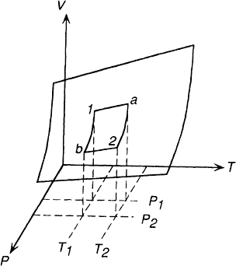



Introduction and Definition of Terms 3
Figure 1.1 The equilibrium states of existence of a fixed quantity of gas in
P-V-T space.
and
Thus
(1.2)
Similarly for the path 1 → b → 2,

Slide 4



4 Introduction to the Thermodynamics of Materials
and
and, hence, again
(1.3)
Eqs. (1.2) and (1.3) are identical and are the physical representations of what is obtained when the complete differential of Eq. (1.1), i.e.,
(1.4)
is integrated between the limits P₂, T₂ and P₁, T₁.
The change in volume caused by moving the state of the gas from state 1 to state 2 depends only on the volume at state 1 and the volume at state 2 and is independent of the path taken by the gas between the states 1 and 2. This is because the volume of the gas is a state function and Eq. (1.4) is an exact differential of the volume V.*
1.3 SIMPLE EQUILIBRIUM
In Figure 1.1 the state of existence of the system (or simply the state of the system) lies on the surface in P-V-T space; i.e., for any values of temperature and pressure the system is at equilibrium only when it has that unique volume which corresponds to the particular values of temperature and pressure. A particularly simple system is illustrated in Figure
1.2. This is a fixed quantity of gas contained in a cylinder by a movable piston. The system is at rest, i.e., is at equilibrium, when
1. The pressure exerted by the gas on the piston equals the pressure exerted by the piston on the gas, and
*The properties of exact differential equations are discussed in Appendix B.

Slide 5
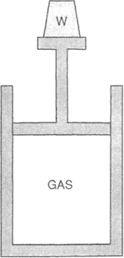
Introduction and Definition of Terms 5
Figure 1.2 A quantity of gas contained in a cylinder by a piston.
2. The temperature of the gas is the same as the temperature of the surroundings (provided that heat can be transported through the wall of the cylinder).
The state of the gas is thus fixed, and equilibrium occurs as a result of the establishment of a balance between the tendency of the external influences acting on the system to cause a change in the system and the tendency of the system to resist change. The fixing of the pressure of the gas at P₁ and temperature at T₁ determines the state of the system
and hence fixes the volume at the value V₁. If, by suitable decrease in the weight placed on the piston, the pressure exerted on the gas is decreased to P₂, the resulting imbalance
between the pressure exerted by the gas and the pressure exerted on the gas causes the piston to move out of the cylinder. This process increases the volume of the gas and hence decreases the pressure which it exerts on the piston until equalization of the pressures is restored. As a result of this process the volume of the gas increases from V₁
to V₂. Thermodynamically, the isothermal change of pressure from P₁ to P₂ changes the state of the system from state 1 (characterized by P₁, T₁), to state 2 (characterized by P₂, T₁), and the volume, as a dependent variable, changes from the value V₁ to V₂.

Slide 6


6 Introduction to the Thermodynamics of Materials
If the pressure exerted by the piston on the gas is maintained constant at P₂ and the temperature of the surroundings is raised from T₁ to T₂, the consequent temperature
gradient across the cylinder wall causes the flow of heat from the surroundings to the gas. The increase in the temperature of the gas at the constant pressure P₂ causes expansion of
the gas, which pushes the piston out of the cylinder, and when the gas is uniformly at the temperature T₂ the volume of the gas is V₃. Again, thermodynamically, the changing of
the temperature from T₁ to T₂ at the constant pressure P₂ changes the state of the system from state 2 (P₂, T₁) to state 3 (P₂, T₂), and again, the volume as a dependent variable changes from V₂ in the state 2 to V₃ in the state 3. As volume is a state function, the final volume V₃ is independent of the order in which the above steps are carried out.
1.4 THE EQUATION OF STATE OF AN IDEAL GAS
The pressure-volume relationship of a gas at constant temperature was determined experimentally in 1660 by Robert Boyle, who found that, at constant T.
which is known as Boyle’s law. Similarly, the volume-temperature relationship of a gas at constant pressure was first determined experimentally by Jacques-Alexandre-Cesar Charles in 1787. This relationship, which is known as Charles’ law, is, that at constant pressure
Thus, in Fig. 1.1, which is drawn for a fixed quantity of gas, sections of the P-V-T surface drawn at constant T produce rectangular hyperbolae which asymptotically approach the P and V axes, and sections of the surface drawn at constant P produce straight lines. These sections are shown in Fig. 1.3a and Fig. 1.3b.
In 1802 Joseph-Luis Gay-Lussac observed that the thermal coefficient of what were called “permanent gases” was a constant. The coefficient of thermal expansion, a, is defined as the fractional increase, with temperature at constant pressure, of the volume of a gas at 0°C; that is
where V₀ is the volume of the gas at 0°C. Gay-Lussac obtained a value of 1/267 for a, but
more refined experimentation by Regnault in 1847 showed a to have the value 1/273. Later it was found that the accuracy with which Boyle’s and Charles’ laws describe the

Slide 7


Introduction and Definition of Terms 7
behavior of different gases varies from one gas to another and that, generally, gases with lower boiling points obey the laws more closely than do gases with higher boiling points. It was also found that the laws are more closely obeyed by all gases as the pressure of the gas is decreased. It was thus found convenient to invent a hypothetical gas which obeys Boyle’s and Charles’ laws exactly at all temperatures and pressures. This hypothetical gas is called the ideal gas, and it has a value of a of 1/273.15.
The existence of a finite coefficient of thermal expansion sets a limit on the thermal contraction of the ideal gas; that is, as a equals 1/273.15 then the fractional decrease in the volume of the gas, per degree decrease in temperature, is 1/273.15 of the volume at 0°C. Thus, at –273.15°C the volume of the gas is zero, and hence the limit of temperature decrease, –273.15°C, is the absolute zero of temperature. This defines an absolute scale of temperature, called the ideal gas temperature scale, which is related to the arbitrary celsius scale by the equation
combination of Boyle’s law
and Charles’ law
where
P₀=standard pressure (1 atm)
T₀=standard temperature (273.15 degrees absolute)
V(T,P)=volume at temperature T and pressure P
gives
(1.5)

Slide 8
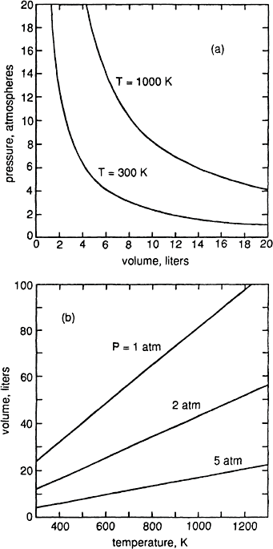
8 Introduction to the Thermodynamics of Materials
Figure 1.3 (a) The variations, with pressure, of the volume of 1 mole of ideal gas at 300 and 1000 K. (b) The variations, with temperature, of the volume of 1 mole of ideal gas at 1, 2, and 5 atm.

Slide 9



Introduction and Definition of Terms 9
From Avogadro’s hypothesis the volume per gram-mole* of all ideal gases at 0°C and 1 atm pressure (termed standard temperature and pressure—STP) is 22.414 liters. Thus the constant in Eq. (1.5) has the value
This constant is termed R, the gas constant, and being applicable to all gases, it is a universal constant. Eq. (1.5) can thus be written as
(1.6)
which is thus the equation of state for 1 mole of ideal gas. Eq. (1.6) is called the ideal gas law. Because of the simple form of its equation of state, the ideal gas is used extensively as a system in thermodynamics discussions.
1.5 THE UNITS OF ENERGY AND WORK
The unit “liter-atmosphere” occurring in the units of R is an energy term. Work is done when a force moves through a distance, and work and energy have the dimensions force×distance. Pressure is force per unit area, and hence work and energy can have the dimensions pressure×area×distance, or pressure×volume. The unit of energy in S.I. is the joule, which is the work done when a force of 1 newton moves a distance of 1 meter. Liter atmospheres are converted to joules as follows:
Multiplying both sides by liters (10^{–3} m³) gives
and thus
*A gram-mole (g-mole, or mole) of a substance is the mass of Avogadro’s number of molecules of the substance expressed in grams. Thus a g-mole of O 2 has a mass of 32 g, a g-mole of C has a mass of 12 g, and a g-mole of CO₂ has a mass of 44 g.

Slide 10
10 Introduction to the Thermodynamics of Materials
1.6 EXTENSIVE AND INTENSIVE PROPERTIES
Properties (or state variables) are either extensive or intensive. Extensive properties have values which depend on the size of the system, and the values of intensive properties are independent of the size of the system. Volume is an extensive property, and temperature and pressure are intensive properties. The values of extensive properties, expressed per unit volume or unit mass of the system, have the characteristics of intensive variables; e.g., the volume per unit mass (specific volume) and the volume per mole (the molar volume) are properties whose values are independent of the size of the system. For a system of n moles of an ideal gas, the equation of state is
where V′ the volume of the system. Per mole of the system, the equation of state is
where V, the molar volume of the gas, equals V′/n.
1.7 PHASE DIAGRAMS AND THERMODYNAMIC COMPONENTS
Of the several ways to graphically represent the equilibrium states of existence of a system, the constitution or phase diagram is the most popular and convenient. The complexity of a phase diagram is determined primarily by the number of components which occur in the system, where components are chemical species of fixed composition. The simplest components are chemical elements and stoichiometric com- pounds. Systems are primarily categorized by the number of components which they contain, e.g., one-component (unary) systems, two-component (binary) systems, three-component (ternary) systems, four-component (quaternary) systems, etc.
The phase diagram of a one-component system (i.e., a system of fixed composition) is a two-dimensional representation of the dependence of the equilibrium state of existence of the system on the two independent variables. Temperature and pressure are normally chosen as the two independent variables; Fig. 1.4 shows a schematic representation of part of the phase diagram for H₂O. The full lines in Figure 1.4 divide the diagram

Slide 11
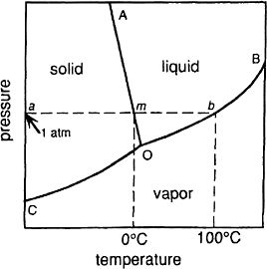
Introduction and Definition of Terms 11
Figure 1.4 Schematic representation of part of the phase diagram for H₂O.
into three areas designated solid, liquid, and vapor. If a quantity of pure H₂O is at some temperature and pressure which is represented by a point within the area AOB, the equilibrium state of the H₂O is a liquid. Similarly, within the areas COA and COB the equilibrium states are, respectively, solid and vapor. If the state of existence lies on a line, e.g., on the line AO, then liquid and solid H₂O coexist in equilibrium with one another, and the equilibrium is said to be twophase, in contrast to the existence within any of the three areas, which is a one-phase equilibrium. A phase is defined as being a finite volume in the physical system with-in which the properties are uniformly constant, i.e., do not experience any abrupt change in passing from one point in the volume to another. Within any of the onephase areas in the phase diagram, the system is said to be homogeneous. The system is hetero- geneous when it contains two or more phases, e.g., coexisting ice and liquid water (on the line AO) is a heterogeneous system comprising two phases, and the phase boundary between the ice and the liquid water is that very thin region across which the density changes abruptly from the value for homogeneous ice to the higher value for liquid water.
The line AO represents the simultaneous variation of P and T required for maintenance of the equilibrium between solid and liquid H₂O, and thus represents the influence of pressure on the melting temperature of ice. Similarly the lines CO and OB represent the simultaneous variations of P and T required, respectively, for the maintenance of the equilibrium between solid and vapor H₂O and between liquid and vapor H₂O. The line
CO is thus the variation, with temperature, of the saturated vapor pressure of solid ice or, alternatively, the variation, with pressure, of the sublimation temperature of water vapor. The line OB is the variation, with temperature, of the saturated vapor pressure of liquid water, or, alternatively, the variation, with pressure, of the dew point of water vapor. The

Slide 12
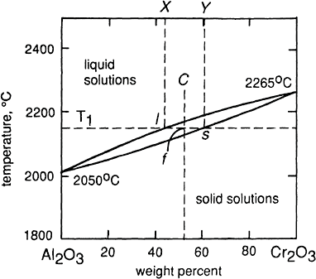
12 Introduction to the Thermodynamics of Materials
three two-phase equilibrium lines meet at the point O (the triple point) which thus represents the unique values of P and T required for the establishment of the three-phase (solid+liquid+vapor) equilibrium. The path amb indicates that if a quantity of ice is heated at a constant pressure of 1 atm, melting occurs at the state m (which, by definition, is the normal melting temperature of ice), and boiling occurs at the state b (the normal boiling temperature of water).
If the system contains two components, a composition axis must be included and, consequently, the complete diagram is three-dimensional with the coordinates composition, temperature, and pressure. Three-dimensional phase diagrams are discussed in Chapter 14. In most cases, however, it is sufficient to present a binary phase diagram as a constant pressure section of the three-dimensional diagram. The constant pressure chosen is normally 1 atm, and the coordinates are composition and temperature. Figure 1.5, which is a typical simple binary phase diagram, shows the phase relation- ships occurring in the system Al₂O₃–Cr₂O₃ at 1 atm pressure. This phase diagram shows that, at temperatures below the melting temperature of Al₂O₃ (2050°C), solid Al₂O₃ and solid Cr₂O₃ are completely miscible in all proportions. This occurs because Al₂O₃ and Cr₂O₃ have the same crystal structure and the Al³⁺ and Cr³⁺ ions are of similar size. At temperatures above the melting temperature of Cr₂O₃ (2265°C) liquid Al₂O₃ and liquid
Cr₂O₃ are completely miscible in all proportions. The diagram thus contains areas of
Figure 1.5 The phase diagram for the system Al₂O₃–Cr₂O₃.

Slide 13
Introduction and Definition of Terms 13
complete solid solubility and complete liquid solubility, which are separated from one another by a two-phase area in which solid and liquid solutions coexist in equilibrium with one another. For example, at the temperature T₁ a Cr₂O₃–Al₂O₃ system of composition between X and Y exists as a two-phase system comprising a liquid solution of composition l in equilibrium with a solid solution of composition s. The relative proportions of the two phases present depend only on the overall composition of the system in the range X–Y and are determined by the lever rule as follows. For the overall composition C at the temperature T₁ the lever rule
states that if a fulcrum is placed at f on the lever ls, then the relative proportions of liquid and solid phases present are such that, placed, respectively, on the ends of the lever at s and l, the lever balances about the fulcrum, i.e., the ratio of liquid to solid present at T₁ is
the ratio fs/lf.
Because the only requirement of a component is that it have a fixed composition, the designation of the components of a system is purely arbitrary. In the system Al₂O₃–Cr₂O₃
the obvious choice of the components is Al₂O₃ and Cr₂O₃. However, the most convenient choice is not always as obvious, and the general arbitrariness in selecting the components can be demonstrated by considering the iron-oxygen system, the phase diagram of which is shown in Fig. 1.6. This phase diagram shows the Fe and O form two stoichiometric compounds, Fe₃O₄ (magnetite) and Fe₂O₃ (hematite), and a limited range of solid solution (wustite). Of particular significance is the observation that neither a stoichiometric compound of the formula FeO nor a wustite solid solution in which the Fe/O atomic ratio is unity occurs. In spite of this it is often found convenient to consider the stoichiometric FeO composition as a thermodynamic component of the system. The available choice of the two components of the binary system can be demonstrated by considering the composition X in Fig. 1.6. This composition can equivalently be considered as being in any one of the following systems:

Slide 14
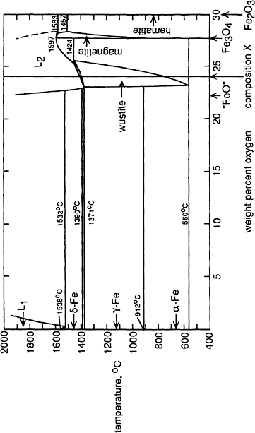
14 Introduction to the Thermodynamics of Materials
Figure 1.6 The phase diagram for the binary system Fe–O.

Slide 15
Introduction and Definition of Terms 15
The system Fe–O (24 weight % O, 76 weight % Fe)
The system FeO–Fe₂O₃ (77.81 weight % FeO, 22.19 weight % Fe₂O₃)
The system FeO–Fe₃O₄ (67.83 weight % FeO, 32.17 weight % Fe₃O₄)
The system Fe–Fe₃O₄ (13.18 weight % Fe, 86.82 weight % Fe₃O₄)
The system Fe–Fe₂O₃ (20.16 weight % Fe, 79.84 weight % Fe₂O₃)
The system FeO–O (97.78 weight % FeO, 2.22 weight % O)
The actual choice of the two components for use in a thermodynamic analysis is thus purely a matter of convenience. The ability of the thermodynamic method to deal with descriptions of the compositions of systems in terms of arbitrarily chosen components, which need not correspond to physical reality, is a distinct advantage. The thermodynamic behavior of highly complex systems, such as metallurgical slags and molten glass, can be completely described in spite of the fact that the ionic constitutions of these systems are not known completely.

